Slide 1
ATLIQ HARDWARE
Sales Insights FROM ad-hoc requests
By Anamika
May 23 2025

Slide 2
Introduction
Atliq Hardware, a leading computer hardware manufacturer in India with international operations, is facing critical decision-making challenges due to insufficient data insights. The management team lacks access to actionable analytics needed to make quick, informed business decisions in a competitive and rapidly evolving hardware market.

Slide 3
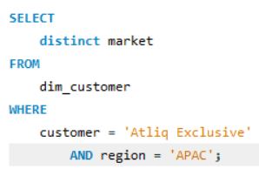
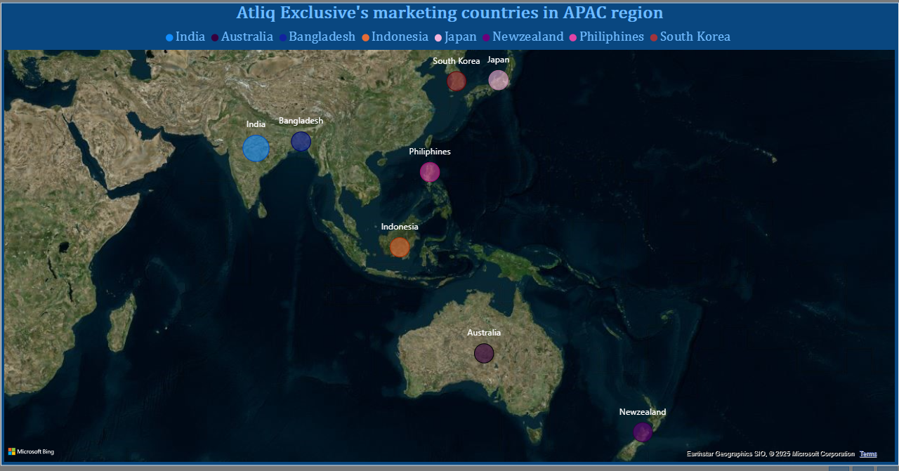
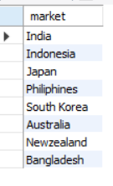
INSIGHTS
Q1. LIST OF MARKETS WHERE CUSTOMER “ATLIQ EXCLUSIVE” OPERATES BUSINESS IN “ASIA PACIFIC” REGION for Fiscal year 2020-2021

Slide 4
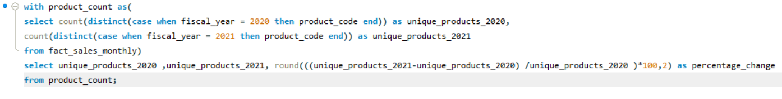
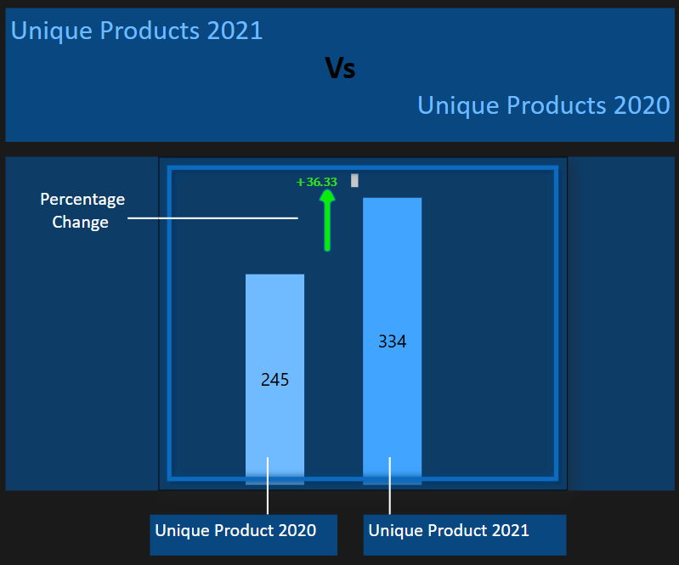

INSIGHTS
Q2. What is the percentage of unique product increase in 2021 vs. 2020?

Slide 5
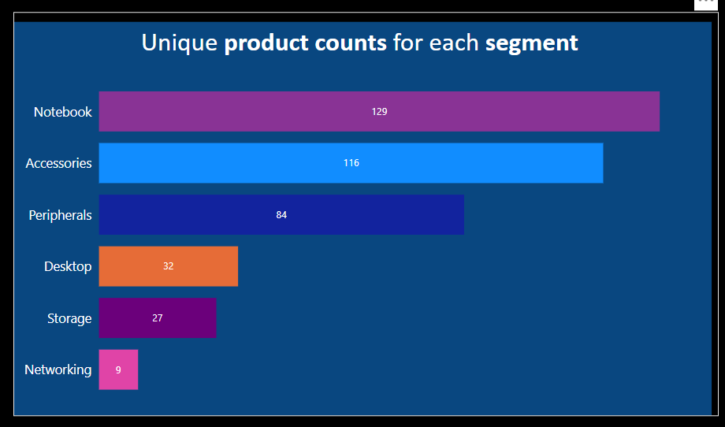
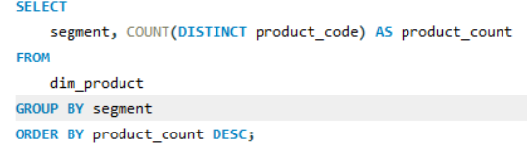
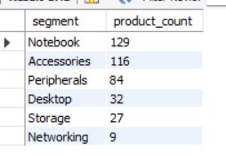
INSIGHTS
Q3.Provide a report with all the unique product counts for each segment.

Slide 6
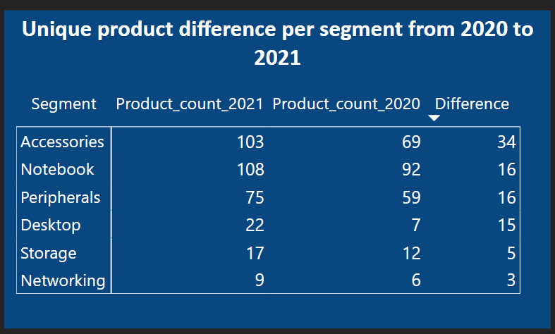
INSIGHTS
Q4. Which segment had the most increase in unique products in 2021 vs 2020?

Slide 7
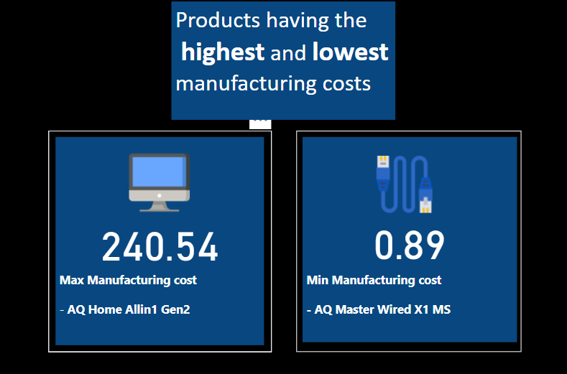
INSIGHTS
Q4 .Get the products that have the highest and lowest manufacturing costs.

Slide 8
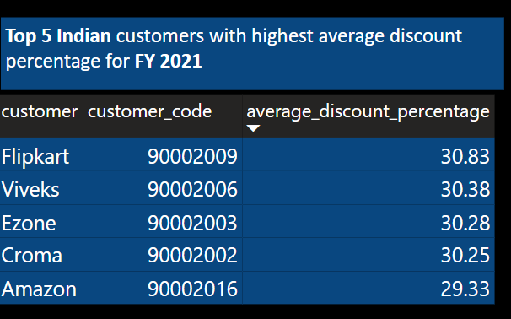
INSIGHTS
Q6. Generate a report which contains the top 5 customers who received an average high pre_invoice_discount_pct for the fiscal year 2021 and in the Indian market.

Slide 9
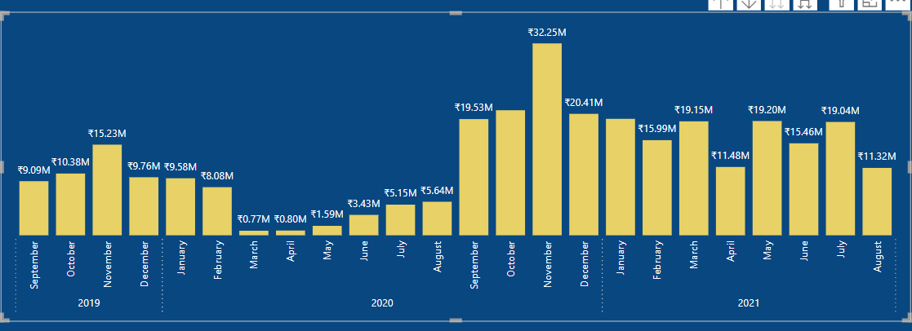
INSIGHTS
Q7.Get the complete report of the Gross sales amount for the customer “Atliq Exclusive” for each month.

Slide 10
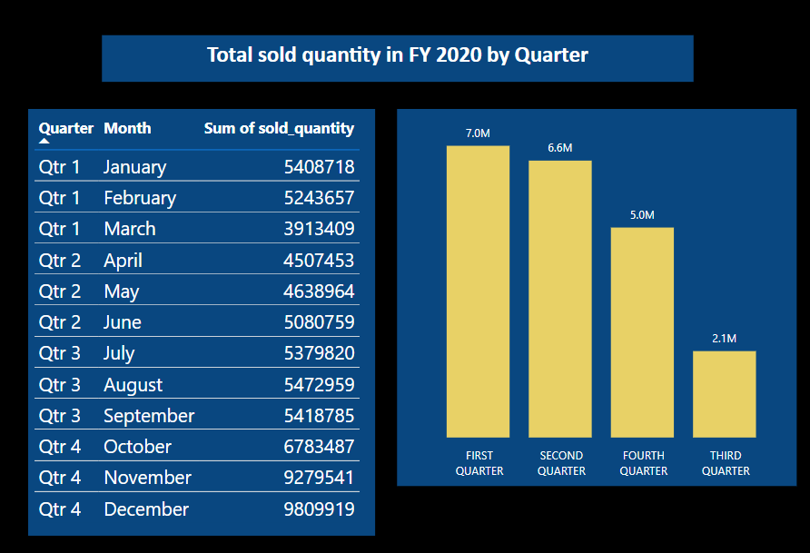
INSIGHTS
Q8. Quarter with max quantities sold for fiscal year 2020

Slide 11
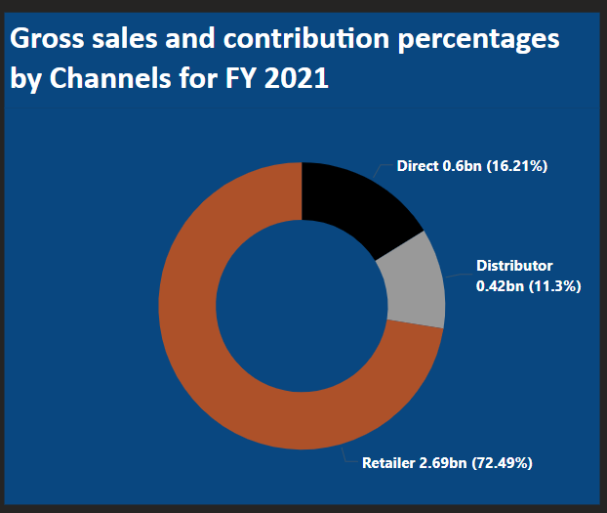
INSIGHTS
Q9. Which channel helped to bring more gross sales in the fiscal year 2021 and the percentage of contribution?

Slide 12
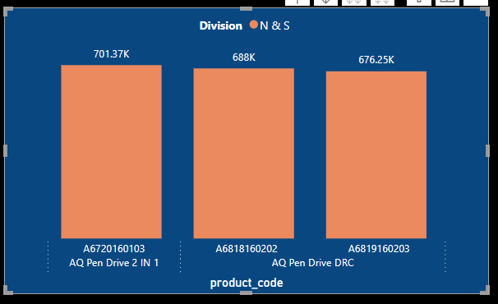
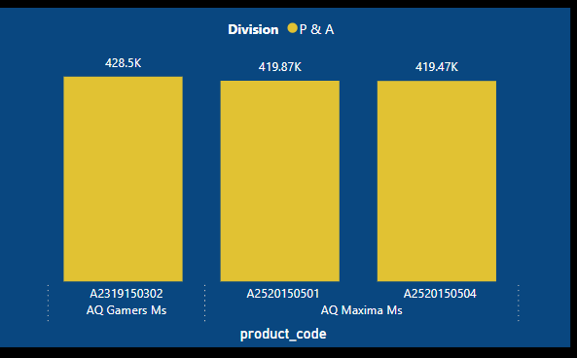
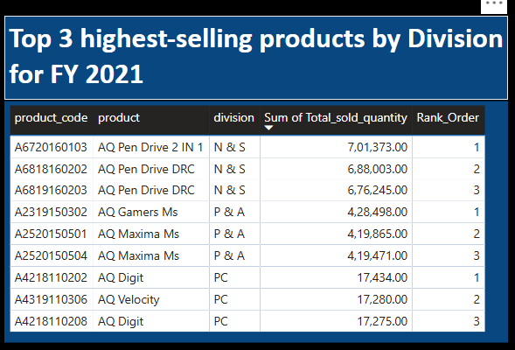
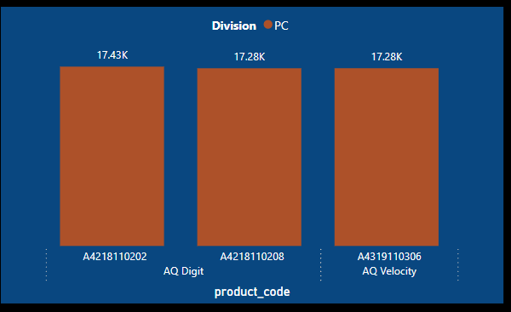
INSIGHTS
Q10. Get the Top 3 products in each division that have a high total_sold_quantity in the fiscal_year 2021?

Slide 13
APPENDIX
GITHUB :-https://github.com/anamika122/Atliq-Hardware-SQL-Challenge---Data-Analytics-Insights
LINKEDIN : - www.linkedin.com/in/anamikay
DATASET (CODEBASICS CHALLENGE):-https://codebasics.io/challenge/codebasics-resume-project-challenge

Slide 14
THANKYOU!!
ANAMIKA
yanamika551@gmail.com

